Slide 1
Programming

Slide 2

Programming
Introduction to Computer Programming
Presented by: Your Name
Date: Insert Date

Slide 3
What is Programming?
Programming is the process of creating instructions for a computer.
These instructions are written in programming languages.
It helps computers perform specific tasks efficiently.

Slide 4
Why is Programming Important?
Builds websites and mobile apps.
Powers games and software.
Automates repetitive tasks.
Supports technologies like Artificial Intelligence and robotics.

Slide 5

Popular Programming Languages
Python
-
Easy to learn, widely used in AI and data science.
Java
-
Common for enterprise and Android applications.
C++
-
Used for games and high-performance software.
JavaScript
-
Makes websites interactive.

Slide 6
Basic Programming Concepts
Variables
Data Types
Operators
Loops
Conditional Statements (if/else)
Functions

Slide 7
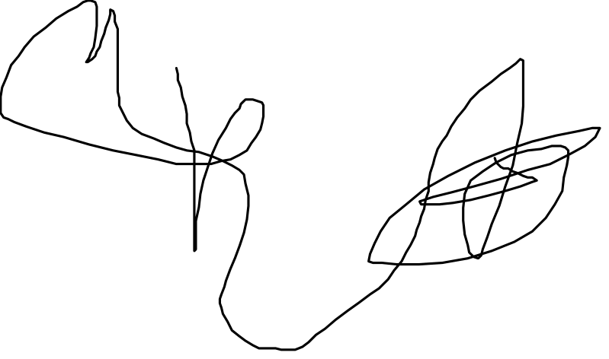
Applications of Programming
Web Development
Mobile App Development
Artificial Intelligence
Data Science
Cybersecurity
Game Development

Slide 8
Web Vs. Mobile App Development
Web Development
Mobile App Development
Creates websites and web applications that run in internet browsers.
Uses technologies such as HTML, CSS, and JavaScript.
Accessible from any device with a web browser and internet connection.
Updates are deployed on the server, so users always access the latest version.
Common examples include e-commerce websites, blogs, and online learning platforms.
Creates applications specifically for smartphones and tablets.
Uses languages and frameworks such as Kotlin, Java, Swift, Flutter, or React Native.
Apps are installed directly from app stores like Google Play or the Apple App Store.
Can access device features such as the camera, GPS, microphone, and sensors.
Common examples include WhatsApp, Instagram, Google Maps, and mobile banking apps.

